Slide 1
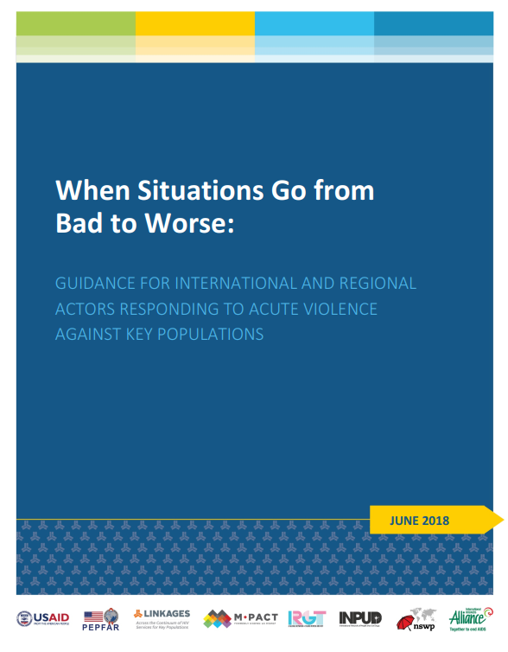
When Situations Go from Bad to Worse
Strengthening collective action during periods of crisis through concrete guidance and principles for engagement
Robyn Dayton, Mohan Sundararaj, Shaun Mellors, JoAnne Keatley, Judy Chang, Gregory Brighton Kata

Slide 2

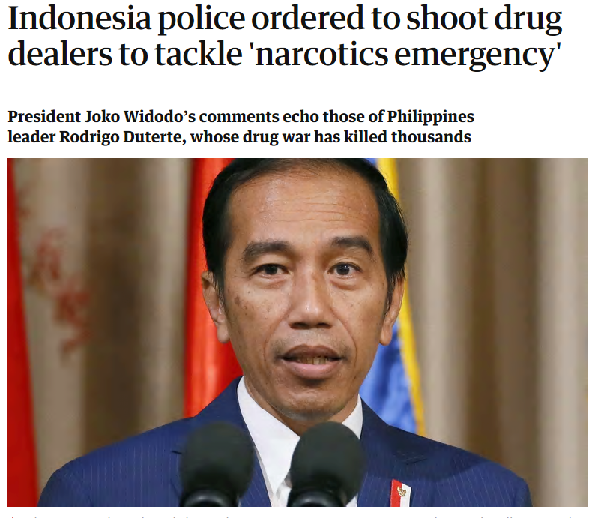

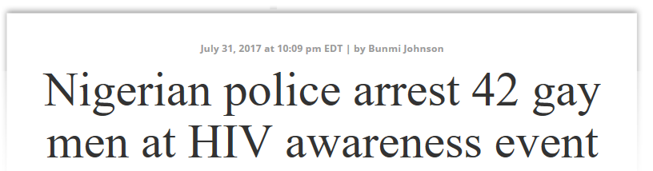
Acute violence is on the rise
Peer educators working with men who have sex with men arrested and tortured
Sex workers abducted and forcibly disappeared
Transgender women attacked and murdered
People who inject drugs subjected to extrajudicial killing
https://www.theguardian.com/world/2017/jul/23/indonesia-police-ordered-to-shoot-drug-dealers-to-tackle-narcotics-emergency
http://www.washingtonblade.com/2017/07/31/nigerian-police-arrest-42-gay-men-hiv-awareness-event/

Slide 3
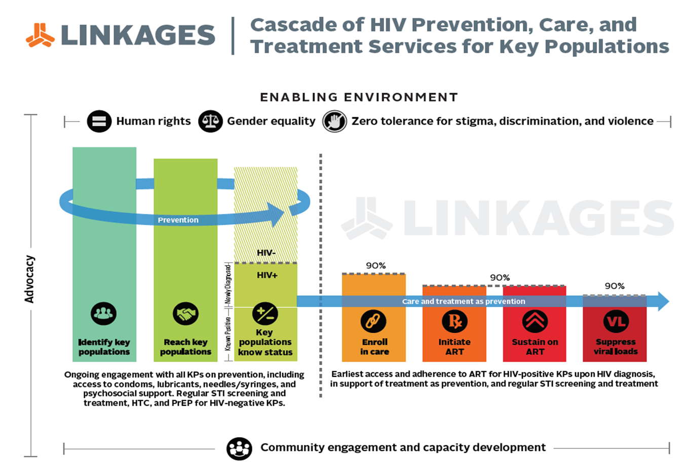
Closure of drop-in-centers, limited or no outreach, lack of access to commodities
Breakdown of referral systems, loss of clinical and outreach staff, reduced adherence among clients

Slide 4
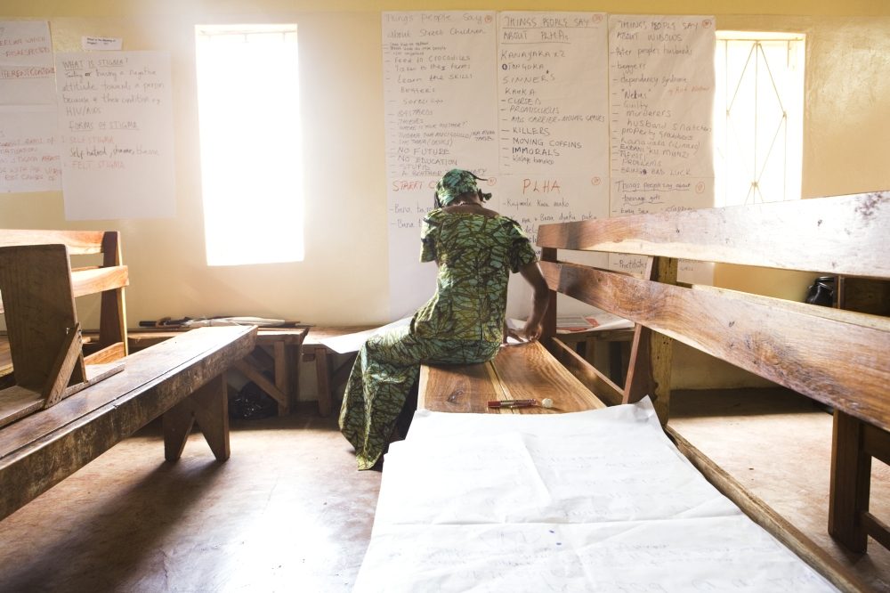
Many international and regional actors have provided support, but....
Chaotic and poorly coordinated efforts
Lack of responsiveness to local actors needs or direction
Fracturing of communities when coalition building is most possible
Photo credit: HIV/AIDS Alliance

Slide 5
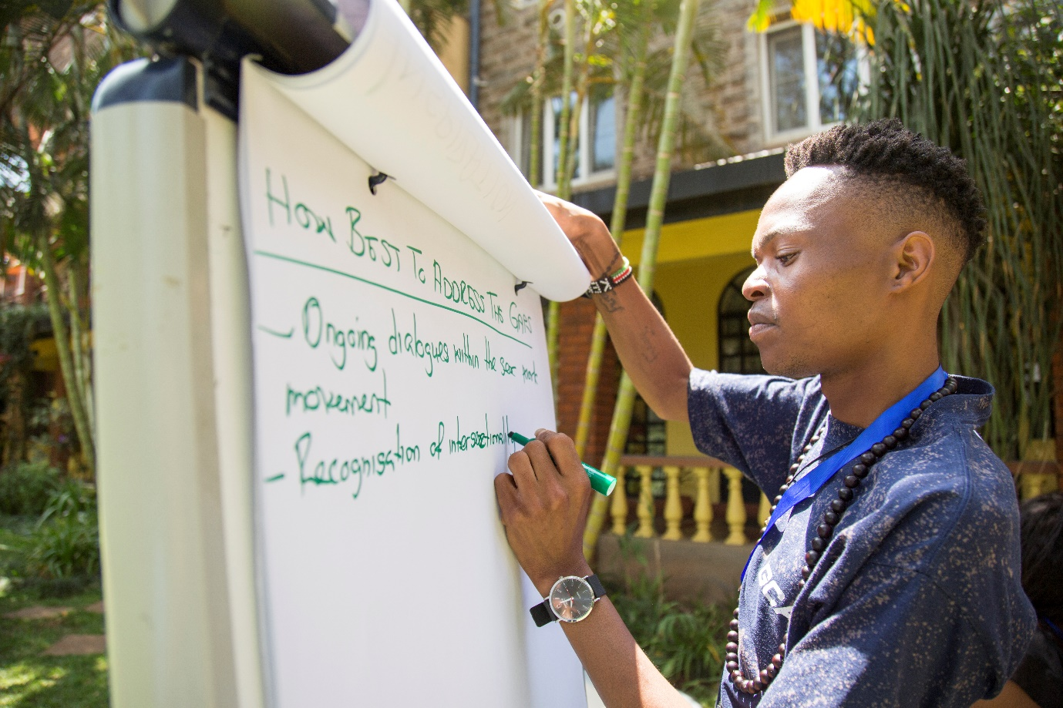
Guidance is needed
Supported by USAID/PEPFAR LINKAGES-convened Technical Advisory Group on Violence, Stigma, and Discrimination Against Key Populations
Developed via interviews and workshop of community-based organizations, United Nations agencies, international nongovernmental organizations, donors, and human rights defenders
Photo credit: Cynthia Matonhodze for International HIV/AIDS Alliance

Slide 6
Organizations involved in developing the brief
Access for All, South Sudan
African Men for Sexual Health and Rights
African Sex Workers Alliance
Aids Fonds
The Bill and Melinda Gates Foundation
Bar Hostess Empowerment Programme, Kenya
Centers for Disease Control and Prevention
CEDAW Committee
Community Health Education Services and Advocacy, Tanzania
Defenders Protection Initiative, Uganda
East African Sexual Health and Rights Initiative, Kenya
East and Horn of Africa Human Rights Defenders Project, Uganda
Eastern African Network of AIDS Service Organisations
Elton John AIDS Foundation
FHI 360
The Global Fund
Global Network of People Living with HIV
Global Network of Sex Work Projects
Heartland Alliance International, Nigeria
House of Empowerment and Awareness in Tanzania
HIVOS
Human Rights Awareness and Promotion Forum, Uganda
Icebreakers Uganda
lNERALA+gh, Ghana
IntraHealth International
International HIV/AIDS Alliance
International Network of People Who Use Drugs
International Community of Women Living with HIV
International HIV/AIDS Alliance
Innovative Response Globally for Transgender Women and HIV
International Treatment Preparedness Coalition
Jinsiangu, Kenya
Johns Hopkins University
Joint United Nations Programme on HIV/AIDS
Kenya Network of People Who Use Drugs
Law Enforcement and HIV Network
Men Against AIDS Youth Group, Kenya
MPact (previously: Global Forum on Men Who Have Sex with Men and HIV)
PACT
Palladium
Population Council
RTI International
Social Health and Empowerment Feminist Collective of Transgender Women, South Africa
Society for Women against AIDS in Africa
Tanzania Sex Workers Alliance
Tanzanian Network of People Who Use Drugs
TB HIV Care, South Africa
Transgender Equality Uganda
Uganda Harm Reduction Network
United Nations Development Programme
United Nations Population Fund
University of Manitoba
University of North Carolina
United States Agency for International Development
Wake Up and Step Forward Coalition, Tanzania
Women's Organisation Network for Human Rights Advocacy, Uganda
World Bank
World Health Organization

Slide 7
Recommendations
Defer to local communities involved in the response
Commit to implementers’ safety by appropriately resourcing their legal and medical needs
Acknowledge and safeguard the unique needs of key populations, including the distinction between men who have sex with men and transgender women
Collaborate and communicate with local actors respectfully
Equitably and transparently align support with the expressed needs of local actors

Slide 8
Recommendations
Defer to local communities involved in the response
Commit to implementers’ safety by appropriately resourcing their legal and medical needs
Acknowledge and safeguard the unique needs of key populations, including the distinction between men who have sex with men and transgender women
Collaborate and communicate with local actors respectfully
Equitably and transparently align support with the expressed needs of local actors

Slide 9
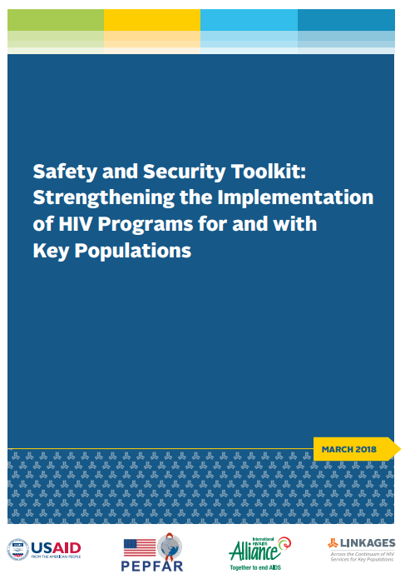
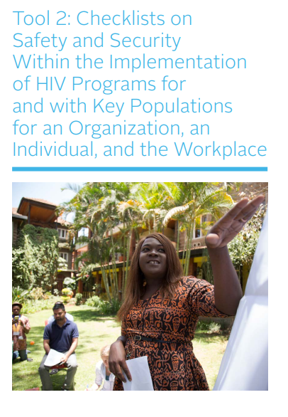
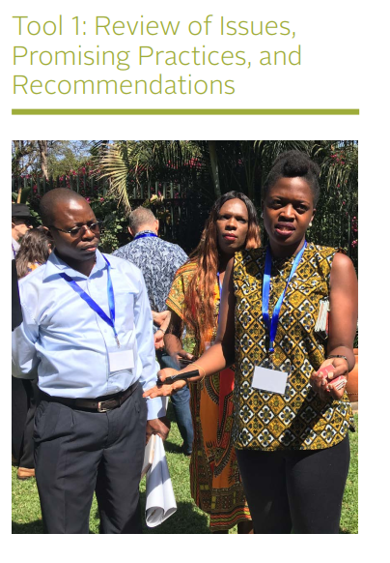
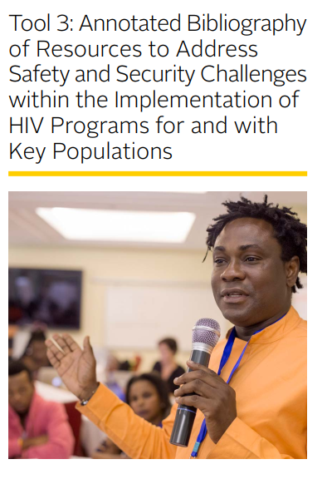
Companion toolkit for implementers
https://www.fhi360.org/sites/default/files/media/documents/resource-linkages-safety-security-toolkit.pdf

Slide 10
Recommendations (cont.)
Ensure that all supported activities avoid victim blaming
Prioritize support for local collectives instead of individual actors
Proactively support the development of mechanisms for local coordination
Preemptively develop mechanisms and norms for international and regional cooperation
Create spaces for continual mutual learning and exchange

Slide 11
All recommendations are firmly situated in broader principles
A proactive investment in “first, do no harm” is fundamental to effective and ethical HIV programs
The protection of human rights is vital to the effective control of the HIV epidemic
Responding to instances of acute violence must be accompanied by a big-picture view

Slide 12
And now what?
Confusion and poor security infrastructure cannot continue to be anticipated hurdles
Neither “do no harm” nor epidemic control will be a reality if security is not adequately addressed
Each of us, collectively, has a role to play
Full brief available at: https://www.fhi360.org/resource/when-situations-go-bad-worse-guidance-international-and-regional-actors-responding-acute

Slide 13


Stay Connected with LINKAGES
Follow LINKAGES on Twitter:
www.twitter.com/LINKAGESproject
Like the project on Facebook:
www.facebook.com/LINKAGESproject
Subscribe to the LINKAGES blog
www.linkagesproject.wordpress.com
Subscribe to The LINK, LINKAGES’s quarterly
project e-newsletter
Check out LINKAGES’s quarterly research digest

Slide 14








Acknowledgments

